Slide 1
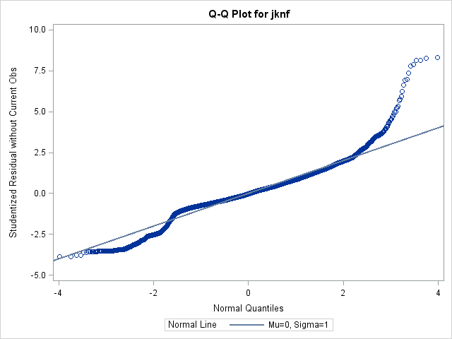
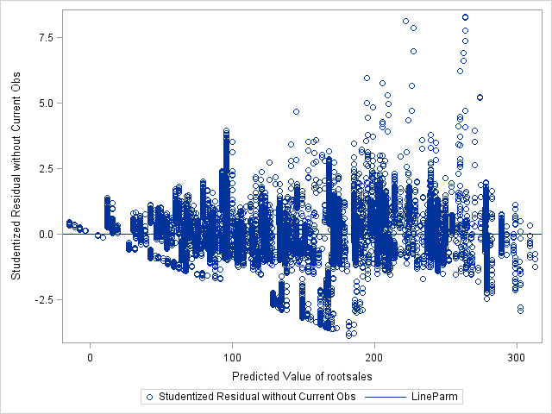
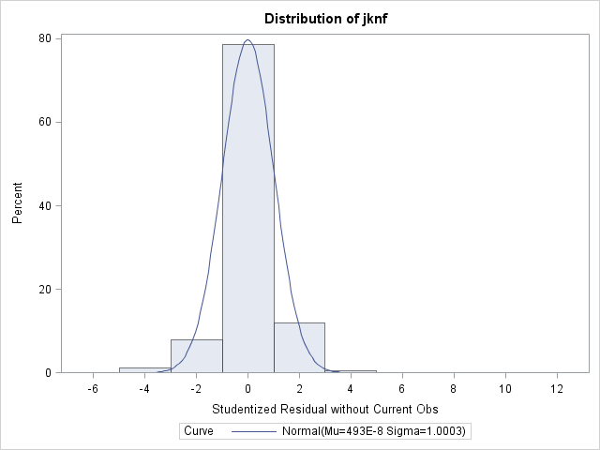
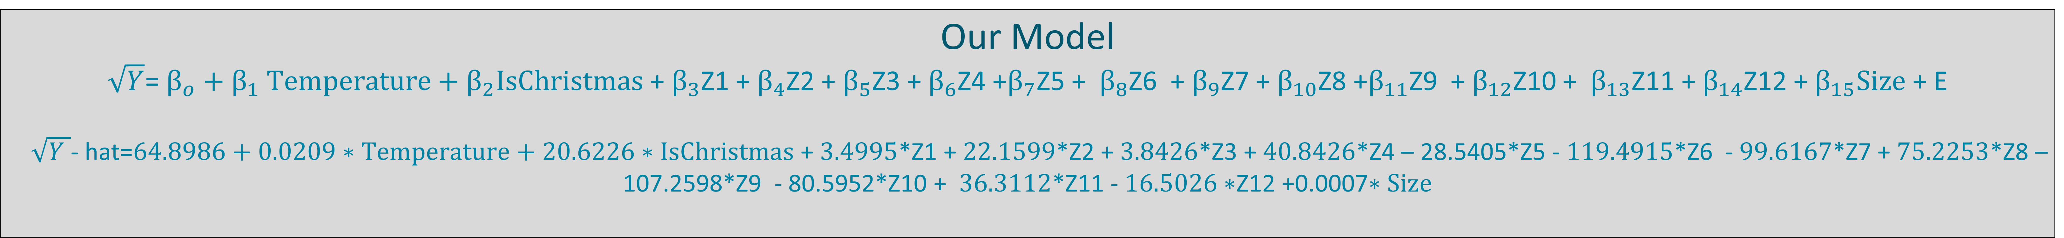
Prediction of Weekly Walmart Sales
BY: Joel Smith and Megan Harris
Goal
Model Building Process
Results
To create a Multiple Linear Regression Model using a combination of predictors that best predicts the weekly sales of Walmart stores.
Understand potential predictors.
Choose variables that appear to have a relationship with weekly sales.
3. Create Dummy Variables
Run over-all F-test and partial F-tests.
Use stepwise selection to see if any variables were insignificant.
Check assumptions and influential points.
Create Transformation.
Re-run over-all F-test using transformation.
Tables for over-all F-test
Q-Q plot of Jackknife Residuals
Analysis of Variance
Source | DF | Sum of Squares | Mean Square | F Value | Pr > F
Model | 15 | 90989225 | 6065948 | 2784.97 | <.0001
Error | 18145 | 39521710 | 2178.10469
Corrected Total | 18160 | 130510934
Potential Model Predictors
Root MSE | 46.67017 | R-Square | 0.6972
Dependent Mean | 144.43325 | Adj R-Sq | 0.6969
Coeff Var | 32.31262
Over-all F-test
The store number
The date
The average temperature of the region
Fuel prices
Mark down sales of Walmart
The consumer price index
Unemployment rate
Holiday week
Different departments
Type of Walmart store
Size of the Walmart store.
Jackknife Vs Predicted Root Weekly Sales
Ho: All β’s = 0
Ha: At least one β’s ≠ 0
F-value = 2784.97
Numerator df = 15 Denominator df = 18145
P-value = <.0001
Reject Ho
R-square = 0.6972
Is Christmas
 | TRUE | FALSE
Z3 | 1 | 0
Store Type
 | A | B | C
Z1 | 1 | 0 | 0
Z2 | 0 | 1 | 0
Department
 | 2 | 5 | 30 | 33 | 38 | 49 | 67 | 72 | 79 | 94
Z4 | 1 | 0 | 0 | 0 | 0 | 0 | 0 | 0 | 0 | 0
Z5 | 0 | 1 | 0 | 0 | 0 | 0 | 0 | 0 | 0 | 0
Z6 | 0 | 0 | 1 | 0 | 0 | 0 | 0 | 0 | 0 | 0
Z7 | 0 | 0 | 0 | 1 | 0 | 0 | 0 | 0 | 0 | 0
Z8 | 0 | 0 | 0 | 0 | 1 | 0 | 0 | 0 | 0 | 0
Z9 | 0 | 0 | 0 | 0 | 0 | 1 | 0 | 0 | 0 | 0
Z10 | 0 | 0 | 0 | 0 | 0 | 0 | 1 | 0 | 0 | 0
Z11 | 0 | 0 | 0 | 0 | 0 | 0 | 0 | 1 | 0 | 0
Z12 | 0 | 0 | 0 | 0 | 0 | 0 | 0 | 0 | 1 | 0
Conclusion
Histogram of Jackknife Residuals
Since p-value is <.05 there is evidence to suggest at least one of the β’s is not equal to 0 indicating a linear relationship between the square root of weekly sales and the model.
69.72% of the variation in the square root of y is explained by the model.
Our Model
$\sqrt{Y}$= $β_{o}{+ β}_{1}Temperature+β_{2}IsChristmas$ + $β_{3}$Z1 + $β_{4}$Z2 + $β_{5}$Z3 + $β_{6}$Z4 +$β_{7}$Z5 + $β_{8}$Z6 + $β_{9}$Z7 + $β_{10}$Z8 +$β_{11}$Z9 + $β_{12}$Z10 + $β_{13}$Z11 + $β_{14}$Z12 + $β_{15}Size$ + E
$\sqrt{Y }$- hat=$64.8986+0.0209∗Temperature+20.6226∗IsChristmas$ + $3.4995$*Z1 + $22.1599$*Z2 + $3.8426$*Z3 + $40.8426$*Z4 – 28.5405*Z5 - $119.4915$*Z6 - $99.6167$*Z7 + $75.2253$*Z8 – 107.2598*Z9 - 80.5952*Z10 + $36.3112$*Z11 - $16.5026∗$Z12 +0.0007$∗Size$

